Slide 1
What Is A Function, Really?
Tutorial #14

Slide 2
OBJECTIVE

Slide 3
Objective
The objective here is for you to understand how a function works. You already know how to write it and call it, but the purpose of this tutorial is to show you how information can flow through it.

Slide 4
TEXTPLANATION

Slide 5
Textplanation
Remember the following words:
Parameter
Argument
Return Value

Slide 6
Textplanation
A couple of tutorials ago, I mentioned how important it was to master information flow. Information is stored, as values, in variables. It’s the lifeblood of your program. If you want your program to work, the right information has to flow to the right places. Functions can be the veins and arteries of your program.

Slide 7
Textplanation
Parameters are the entrance points for information into your function.
Arguments are the bridges for information between your function call and your function.
Return values are the exit points for information.

Slide 8
Textplanation
Let’s start with what we’ve seen.
x = parseInt (“123Hello.”);
We know that this is a function call and we know that it’s going to turn “123Hello” into a 123 and store that in x. Which of those three words from above is the “123Hello”?

Slide 9
Textplanation
Think about it.

Slide 10
Textplanation
Keep thinking.

Slide 11
Textplanation
Make an educated guess and have an answer before you move on.

Slide 12
Textplanation
No. Really.

Slide 13
Textplanation
It’s an argument. An argument holds a value. That can come in the form of something literal, like “123Hello” or the number 3, or it can come in the form of a variable. Either way, that value is passing into the function through the call.

Slide 14
Textplanation
The function needs a way to receive it so that it can work with it. That’s the parameter. The parameter is always a variable. So, the function call to parseInt passes through a string, which means that the function alert has a parameter set to receive that string.

Slide 15
Textplanation
What about the return value?

Slide 16
Textplanation
Some functions, like parseInt, are tasked with manufacturing a value. This is not to be confused with a variable. Though the value can be carried by a variable, the value is what’s important. Once the function’s job is done and the value has been manufactured, the function returns that value.

Slide 17
Textplanation
If you look at the example: x = parseInt (“123Hello”); it’s hopefully obvious that the value went into x.

Slide 18
CONSTRUCTION

Slide 19
Construction
Create a folder somewhere on your drive and label it Functions.
Open up notepad++.
Save the empty file to your folder and name the file “index.html”.
All first pages on a website are called index.
As you go through the images of the construction, add to your code. You will see comments with explanations of what you are doing. Those comments will change with each slide. You should not type my comments into your code.

Slide 20
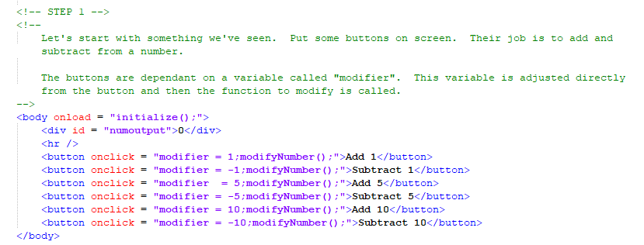
Construction

Slide 21
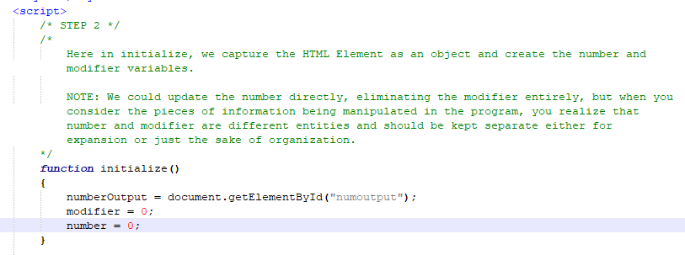
Construction

Slide 22
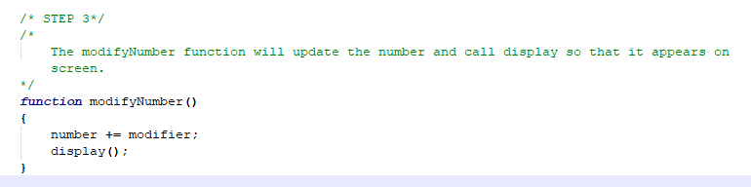
Construction

Slide 23
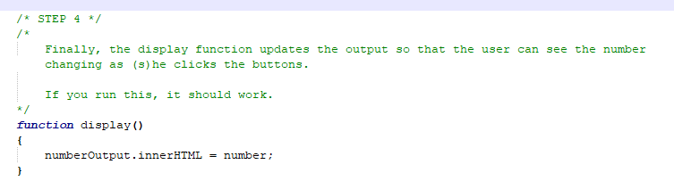
Construction

Slide 24
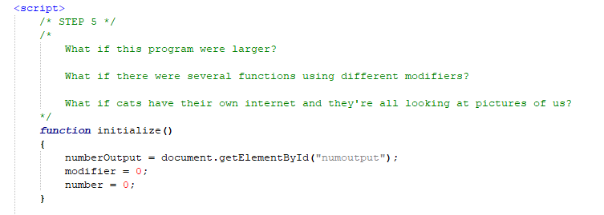
Construction

Slide 25
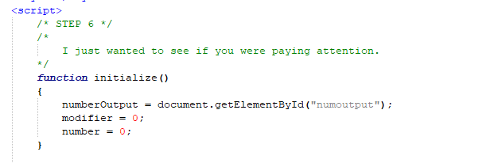
Construction

Slide 26
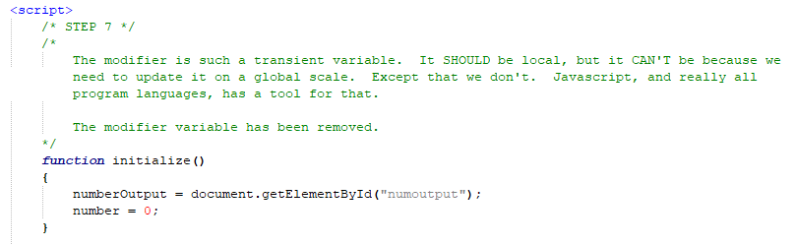
Construction

Slide 27
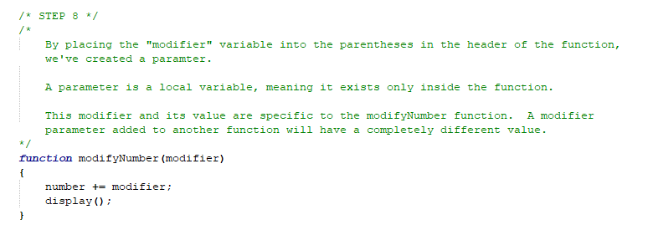
Construction

Slide 28
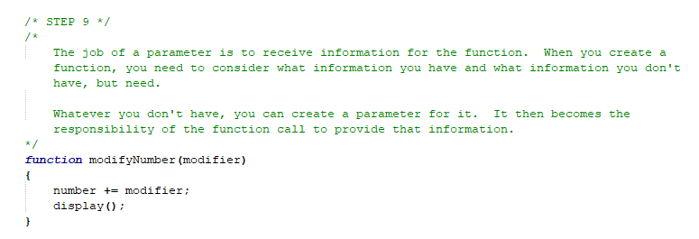
Construction

Slide 29
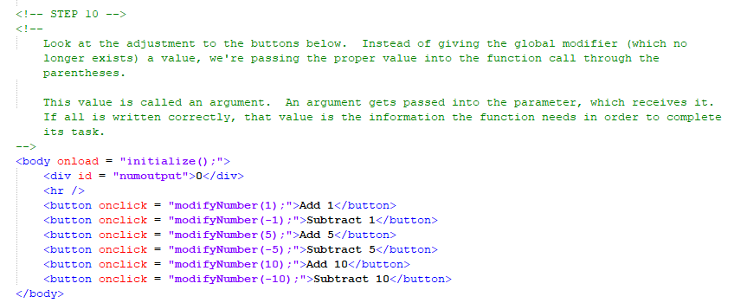
Construction

Slide 30
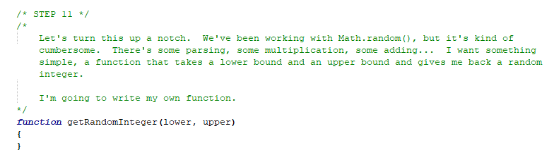
Construction

Slide 31
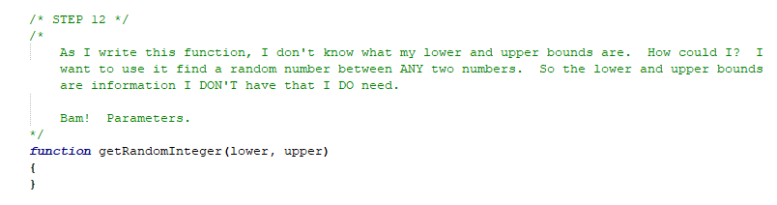
Construction

Slide 32
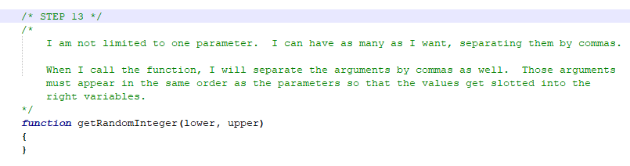
Construction

Slide 33
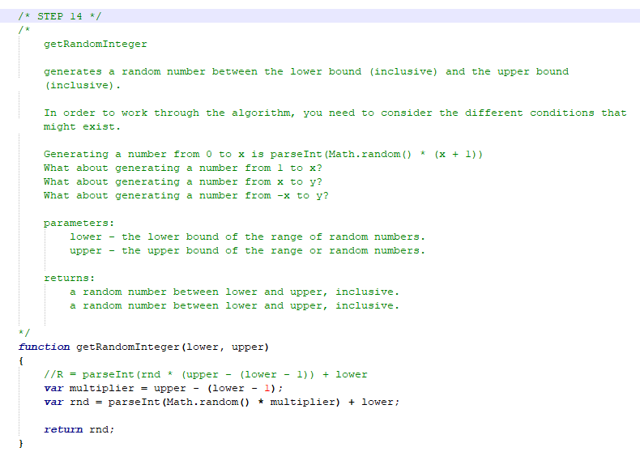
Construction

Slide 34
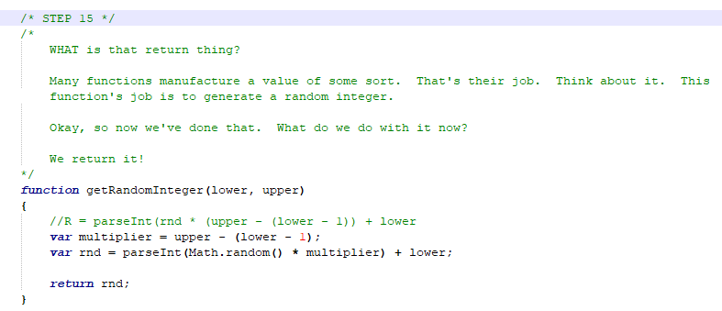
Construction

Slide 35
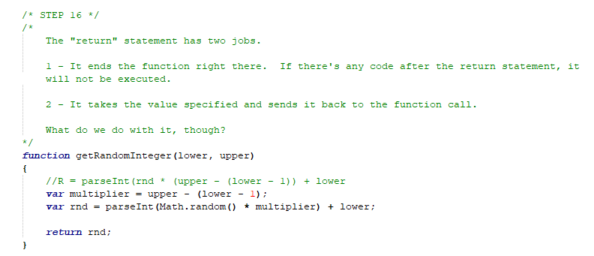
Construction

Slide 36
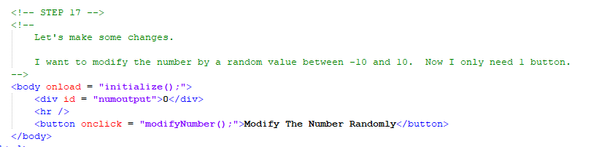
Construction

Slide 37
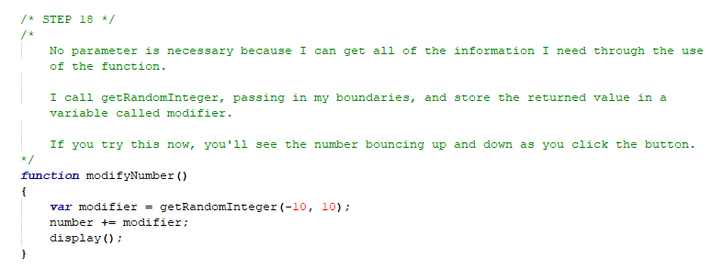
Construction

Slide 38
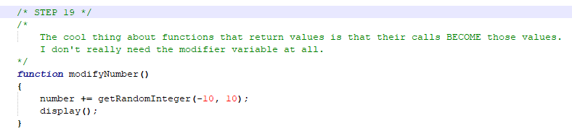
Construction

Slide 39
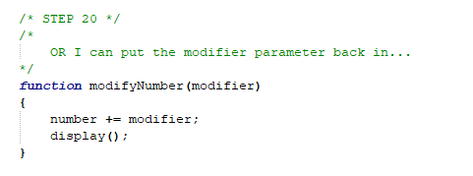
Construction

Slide 40
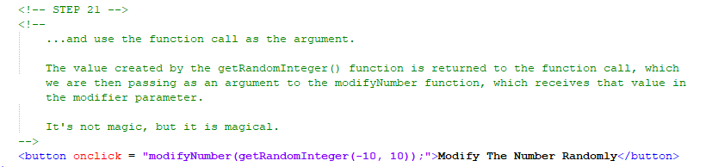
Construction

Slide 41
A DEEPER MEANING

Slide 42
A Deeper Meaning
Take a look at these two pieces of code.
x = 15;
x = parseInt (“123Hello”);

Slide 43
A Deeper Meaning
Both of these are assignment statements. If you remember, an assignment statement has an assignment operator (=), a variable on the left, and a value on the right.

Slide 44
A Deeper Meaning
The variable is x in both cases.

Slide 45
A Deeper Meaning
Zen.

Slide 46
A Deeper Meaning
But what about the value? The first value is 15, right? What about the second one? In the second one, the value comes from function call. More to the point, the function call is the value.

Slide 47
A Deeper Meaning
When a function that returns a value is called, the function call becomes that value.

Slide 48
A Deeper Meaning
Read that again.

Slide 49
A Deeper Meaning
When a function that returns a value is called, the function call becomes that value.

Slide 50
A Deeper Meaning
This is no trifling realization. Sequencing through functions as tasks is pretty easy, but when you have to start thinking of them as values because of what they return, it opens up a whole new dimension of how and when and where you can actually make function calls.

Slide 51
A Deeper Meaning
Think about math. How do you represent a function?

Slide 52
A Deeper Meaning
f(x) = x + 2
f(3) = 3 + 2
f(3) = 5
f(x) is a function.
x is the parameter.
3 is the argument.
5 is the return value.
g(x) = x / 2
g(f(3)) = ?
f(3) returns a value (5), which is then passed into g(x), which returns another value.

Slide 53
A Deeper Meaning
Chew on that for a while.

Slide 54
FAQ

Slide 55
FAQ
When do I use a parameter?
When you need one. Parameters are a good reason to plan out your solution before coding it. When you sit down to write a function, you need to think about what that function needs to do and what information is necessary to that task. If there’s any of that information missing, don’t stop to look for it. Create a parameter to receive it. Most of the time, when you go to call that function, you will realize that that information is available.

Slide 56
FAQ
When do I use a return value?
When you need one. If your function manufactures a value, your instinct will be to store it in some global variable. Sometimes that’s okay. The variable may be important to the program as a whole. But, if that value is important to the moment, just return it. Wherever the function is being called, that value will be returned and you can use it as necessary.

Slide 57
FAQ
Why do you keep saying, “when you need one”?
One of the biggest pitfalls of learning program is approaching it incorrectly. There are no formulae for writing a program. You can’t memorize something you’ve seen and universally fit it into a neat package. Understand the problem. Design a solution. Code the solution. Use the tools you have when you need them.

Slide 58
ACTIVITY

Slide 59
Roll the Dice
Using the getRandomInteger function, write a page that rolls the dice. The user can choose how many times to roll the dice by clicking plus and minus buttons (1, 5, and 10). When the number of rolls is determined, the user can click the roll dice button and watch as the results go by.
The page should keep track of how many of each number was rolled and the average of all of the rolls. Display this information on the page.

